Slide 1
Operating Systems Human-Machine Interaction

Slide 2
Presentation Plan
Why an Operating System
Outline What the Project Is
Some of the Main Components
The End Result
Questions

Slide 3
Notes:
This is where all operating systems begin
A blank canvas is both daunting and full of possibilities.
There are no safety nets, nothing to depend upon unless you yourself have written it.
I really didn’t know where this was going to go.
It evolved as it was developed

Slide 4
The Goal
Notes:
I didn’t think it would include a GUI, we have Brendan to thank for that
For challenging me by asking the question why?
Operating Systems are not about controlling hardware, their only true purpose is in bringing humans and
machine together, and allowing a human to speak to a machine on human terms.

Slide 5
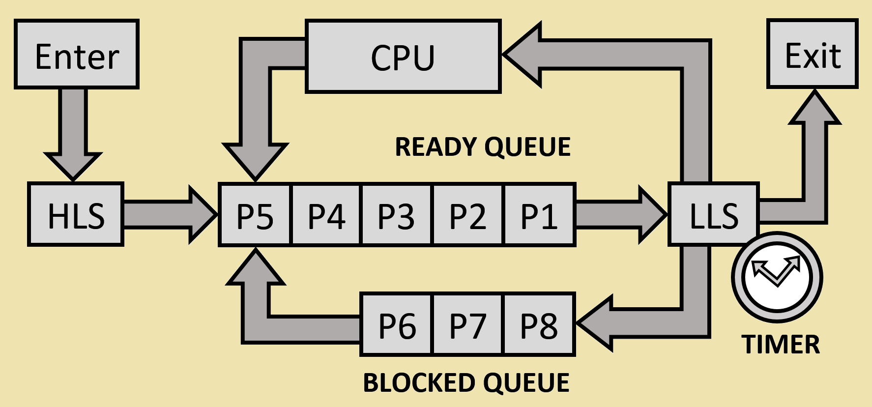
Process Scheduler
Notes:
Managing Time as a Resource, frequency is milliseconds
One programs is executing, the rest are effectively put sleep

Slide 6
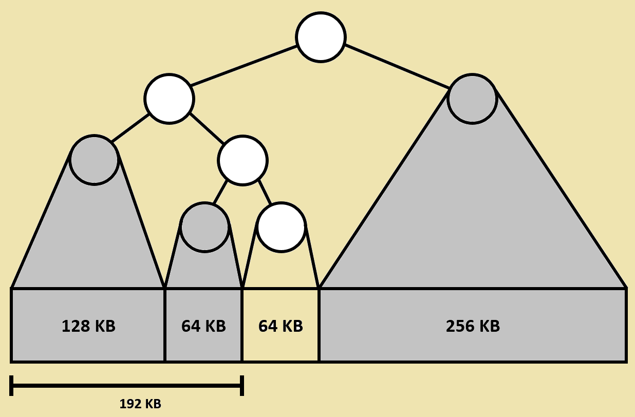
Virtual Memory Manager
Notes:
Manages memory as a resource. Uses virtual memory
which protects other programs from accidental or malicious overwrite
Also assigns ownership to regions of memory

Slide 7
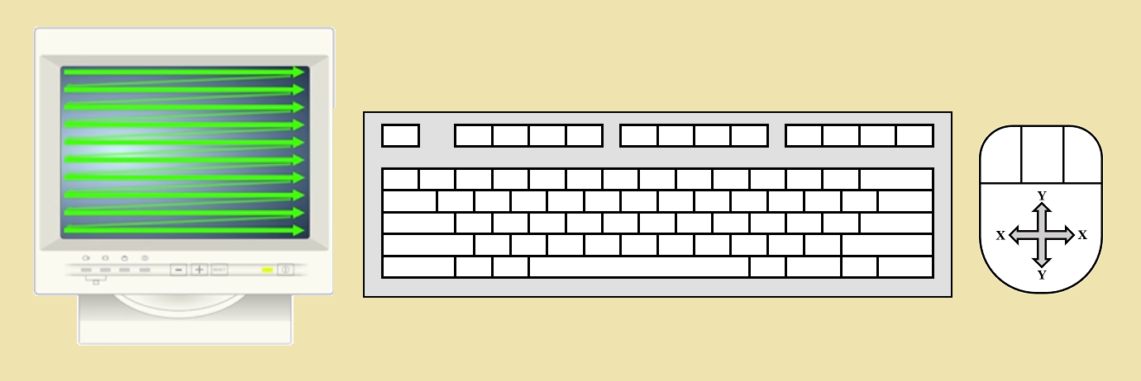
Device Support
Notes:
Devices are the only means of getting information in or out of the system
They are the bridge between the human and the machine

Slide 8
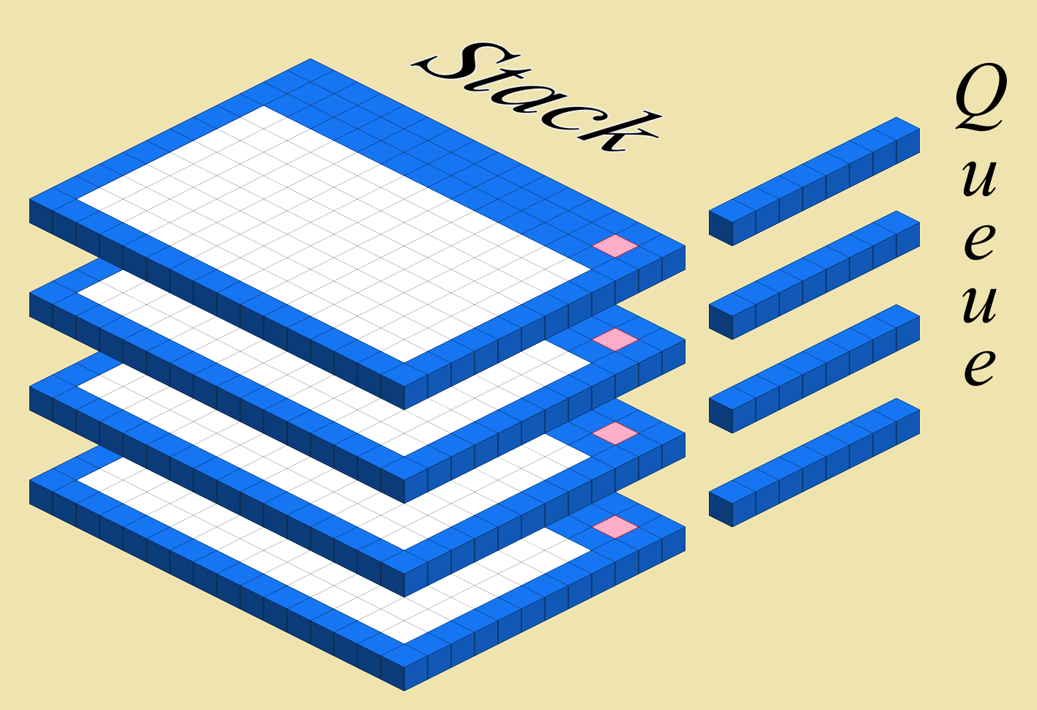
Windows and Event Queues
Notes:
Talk through an OnClick event as an example

Slide 9
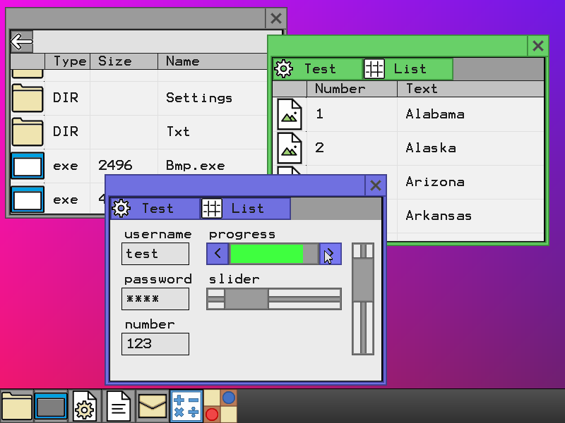
Notes:
Before I was of the opinion that an operating system controlled hardware, what I have learnt is that Humans are more important in software than we give them credit for.

Slide 10
Questions?
Notes:
What have I learnt?
At the beginning, the question I had was “Can a student commit to taking on a project like this?”
The question I have now is “Can a student afford not to?”
I see this project was a rite of passage, I have truly grown in the process.

